Slide 1

What’s your Pease Number?
“The Pease number is the most important meaningless mathematical constant ever.”
- Richard Thompson Expert in sementic nonsense

Slide 2
Pease constant defined
Your Birthday (YB) = [MM DD YYYY]
Fibo Birthday Constant (FBC) = [Fibo(YB[0]) Fibo(YB[1])]
Collatz Fibo-Birthday (CFB)
= [Collatz(FBC[0]) Collatz(FBC[1]) Collatz(YB[2])]
Pease constant = CFB[0] + CFB[1] + CFB[2]

Slide 3
Example – April 10, 1982
Example Birthday (April 10) = [4 10 1982]

Slide 4
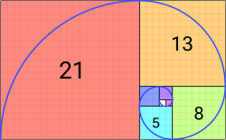
Fibonacci Birthday
n0 = 0
n1 = 1
n2 = n0 + n1
n3 = n1 + n2
etc.
Example Birthday (April 10) = [4 10 1982]
Fibo Birthday Constant (FBC) = [Fibo(MM) Fibo(DD)] = [3 55]

Slide 5
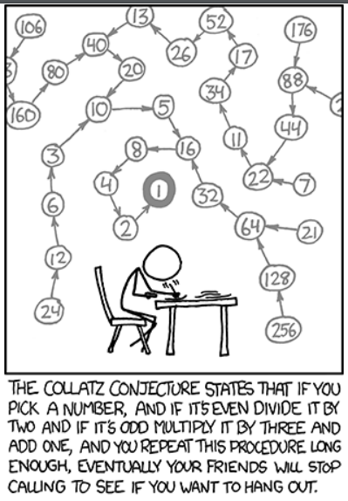

Collatz Sequence
- If the number is even, divide by two.
- If the number is odd, multiply by three and add one
- Repeat until you get to 1
Source: XKCD, Randall Monroe, March 5, 2010

Slide 6
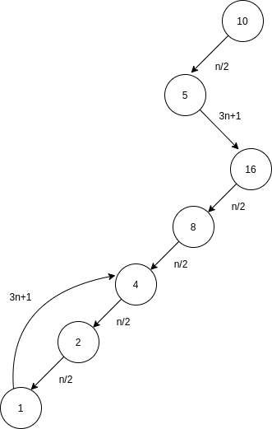
Collatz Fibo-Birthday Number
For our lab, the Collatz number is:
the number of steps to get from your Fibonacci birthday to 1
Example Birthday (April 10) = [4 10 1982]
Fibo Birthday Constant (FBC) = [Fibo(MM) Fibo(DD)] = [3 55]
Collatz Fibo-Birthday (CFB)
= [Collatz(FBC[0]) Collatz(FBC[1]) Collatz(YB[2])]
= [Collatz(3) Collatz(55) Collatz(1982)]
= [7 112 99]
Notes:
Graphic source: https://www.cantorsparadise.com/the-collatz-conjecture-beauty-or-conundrum-of-mathematics-6589e45babf7

Slide 7
Pease Number
Example Birthday (April 10) YB = [4 10 1982]
Fibo Birthday Constant (FBC) = [Fibo(YB[0]) Fibo(YB[1])] = [3 55]
Collatz Fibo-Birthday (CFB) = [Collatz(FBC[0]) Collatz(FBC[1])] = [7 112 99]
Pease constant = CFB[0] + CFB[1] + CFB[2]
= 7 + 112 + 99
= 218

Slide 8

Objective
1. User prompted to input a Month, Day, and a Year
2. Pease number is calculated and displayed to the screen
3. Go to step 1.

Slide 9
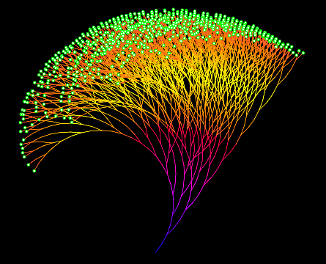
Rules
Implement in Python in a pure functional style:
- Only use pure functions
- No loops
- No mutation or side-effects outside of main
  Only exception is reading/writing to lookup table.
- All calculations must be memoized
  Only calculate any one value once, ever.
  Find previous calculations in lookup table.
- No AI to generate code.

Slide 10
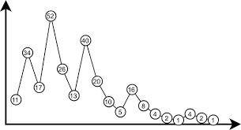
Extra credit opportunities
Extra Credit (16.67%) for using Monadic chaining operations (I can help if needed).
Extra Credit (16.67%) for error detection Boolean function that:
  Returns true if a given number converges to 1 in the Collatz sequence
  Returns false if it does not converge (i.e., gets caught in a loop, or grows forever).
Extra Credit (16.67%) Mimic the closure pattern in Python and maintain the lookup table within the closure.
All three, +50% on the final exam.

Slide 11
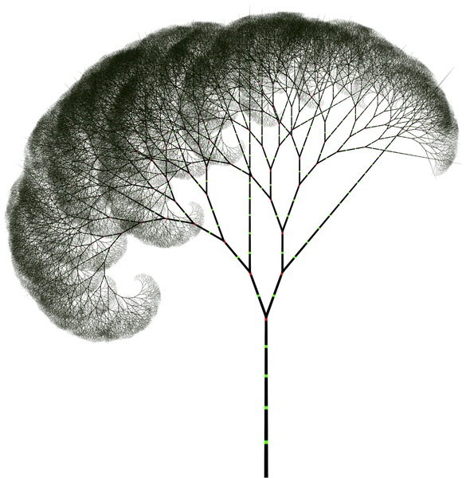
Deliverables
* Upload your final code to Github.
* Send me an email (richard.thompson@nps.edu) with a link to your repository.

